Slide 1
Knowledge Byte
  In this section, you will learn about:
    Passing Parameters in RMI
    RMI over IIOP
    Introduction to JNDI

Slide 2
Passing Parameters in RMI
  The two methods that enable you to pass parameters to invoke a remote method across a network are:
    Pass-by-value
    Pass-by-reference

Slide 3
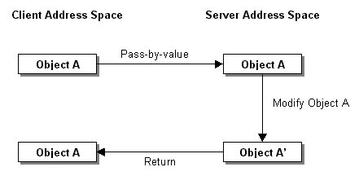
Passing Parameters in RMI (Contd.)
  Pass-by-value method:
    Passes a copy of the original data to the remote method.
    Changes made by the remote method are reflected only in the copy of the original data. The original data values remain unaffected.
    The following figure shows how to pass parameters using pass-by-value method:

Slide 4
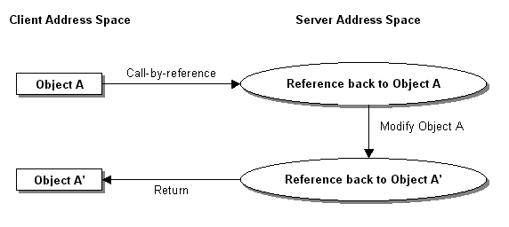
Passing Parameters in RMI (Contd.)
  Pass-by-reference method
    Passes the original data as parameters to the remote method.
    Changes made by the remote method are reflected in the original data.
    The following figure shows passing the parameters using pass-by-reference method:

Slide 5
RMI Over IIOP
  RMI-IIOP:
    Combines the features of RMI with the interoperability of the IIOP (Internet Inter-ORB Protocol).
    Enables you to create distributed objects in Java.
    Allows creating applications that can communicate with Common Object Request Broker Architecture(CORBA).
    Enables you to pass Java objects between various application components either by value or by reference.
    Uses two packages:
      java.rmi
      javax.rmi
    Uses two protocols
      IIOP
      Genera Inter ORB Protocol (GIOP)

Slide 6
RMI Over IIOP (Contd.)
  You can generate the IIOP stub and skeleton using the -iiop option with the rmic command as shown:
  rmic -iiop [implementation CLASS file]
  Creates a distributed application without using the Interface Definition Language (IDL) or mapping with different languages.
  GIOP:
    Defines the structure and formats for passing the messages over ORB architectures.
    Provides seven layers architecture.
    Enables communication between multiple applications across different platforms.

Slide 7
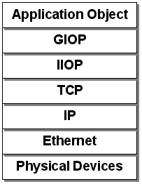
RMI Over IIOP (Contd.)
  GIOP Architecture

Slide 8
Introduction to JNDI
  Java Naming and Directory Interface (JNDI):
    Is an Application Program Interface (API) that provides naming and directory services to Java applications.
    Provides information about the applications, naming services, networks, and end-users.

Slide 9
Introduction to JNDI (Contd.)
  Uses of JNDI in RMI:
    The RMI registry service provider enables JNDI applications to access remote objects that are registered in the RMI registry.
    The JNDI service provider binds a naming context to an RMI object.
    You can access the remote object from any namespace location using the naming context associated with the RMI object.
    An RMI client does not require the host name or port number of the RMI registry to access the remote object.
    JNDI environment properties:
      java.naming.factory.initial
      java.naming.provider.url
      java.naming.factory.state
      java.naming.factory.object

Slide 10
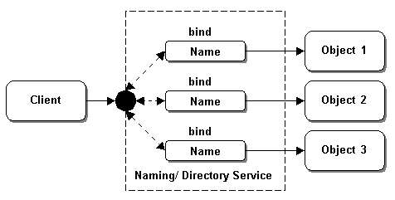
Introduction to JNDI (Contd.)
  Binding the Naming Context to Objects using JNDI

Slide 11
Introduction to JNDI (Contd.)
  JNDI Architecture:
    Contains the following components:
      Java Application
      JNDI API
      JNDI Naming and Directory Manager
      JNDI Service Provider Interface (SPI)

Slide 12
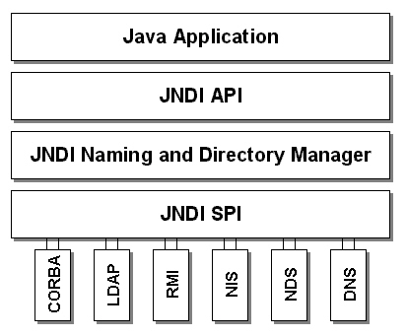
Introduction to JNDI (Contd.)
  JNDI Architecture

Slide 13
Introduction to JNDI (Contd.)
  J2EE application server includes the following service providers for naming and directory services:
    CORBA
    Lightweight Data Access Protocol (LDAP)
    RMI
    Network Information System (NIS)
    Novell Directory Services (NDS)
    Domain Name Service (DNS)

Slide 14
From the Expert’s Desk
  In this section, you will learn:
    Best practice on using SecurityManager class in RMI applications
    Tip on enhancing performance of RMI calls
    FAQs on RMI

Slide 15
Best Practices
Using the SecurityManager Class in RMI Applications
  The RMI SecurityManager class provides a security manager that:
    Implements the security policies for the RMI applications.
    Prevents the unauthenticated user to access the method stored on RMI server.
    Checks if any security check is currently in progress or not
    Ensures that a network connection is secure or not
    Ensures that the dynamic libraries can be linked or not
    Secures the RMI application from virus attacks.

Slide 16
Best Practices
Using the SecurityManager Class in RMI Applications (Contd.)
  You can use the following code snippet to implement the SecurityManger class in an RMI client:
  System.setSecurityManager(new RMISecurityManager())
  You have to create a policy file to assign the security permissions to an RMI client.
  The policy file is saved as .java.policy file and is stored in the installation directory.
  You can use the following code snippet to create a policy file:
  grant
  { permission java.net.SocketPermission "*:1024-65535", "connect";
  };

Slide 17
Tips
Enhancing Performance of RMI Calls
  To enhance the performance of RMI calls, pass the serialize primitive type instead of passing the objects as parameter.
  Passing the primitive type across the network is much faster than the passing the object as a parameter.
  To enhance the performance of RMI calls, try minimizing the number of remote method invocations that a client will need to make.
  For example,
    If your RMI server application provides information of flight information, define a single remote method that returns all flight information in an object instead of defining remote methods, such as, getFlightName(), getFlightDeparture(), and getFlightArrival() for each information.

Slide 18
FAQs
  How can you modify the default port of the RMI registry?
  You can modify the default port of the rmi registry by specifying a port at the command prompt. The command to change the default port number is:
  start rmiregistry 1234

Slide 19
FAQs (Contd.)
  Can you send a ResultSet object back to the client using RMI?
  You cannot send the ResultSet object back to the client over RMI communication because the java.sql.ResultSet interface is not a serializable object. But if you want to send the ResultSet object over RMI connection, you need to use the following methods:
    Extract data from the ResultSet object, encapsulate the data in serializable objects, and pass them through RMI.
    Wrap the ResultSet object in the remote object and register the remote object to the RMI registry. As a result, a client can access the remote object.

Slide 20
FAQs (Contd.)
  How can you dynamically register a remote object to the RMI registry?
  You can dynamically register a remote object to the RMI registry with the help of the forName() method of the java.lang.Class package. The Class.forName() method dynamically loads the class, creates the instances of the class, and registers the class objects to the RMI registry. To dynamically register a remote object to the RMI registry, you need a class name and object name. The class name provides a class that you want to instantiate. The object name provides name of the remote object under which you register the instance of the class.
  Why is the server-side skeleton class not required in J2SDK 1.2 or later versions?
  The J2SDK1.2 or above version have an additional stub protocol that eliminates the need for a skeleton.

Slide 21
FAQs (Contd.)
  Can a single RMI client connect to multiple RMI servers simultaneously?
  Yes, a single RMI client can communicate to multiple RMI server, simultaneously. You can use the following code snippet to connect a single RMI client to multiple RMI servers:
  Server1 ser1 = (Server1)Naming.lookup("rmi://server1.host/server1");
  Server2 ser2 = (Server2)Naming.lookup("rmi://server2.host/server2");
  Server3 ser3 = (Server3)Naming.lookup("rmi://server3.host/server3");

Slide 22
FAQs (Contd.)
  How can you programmatically stop an RMI server?
  When you start an RMI server, a Java thread is automatically started. The Java thread does not stop even if you stop the RMI server. As a result, the RMI server remains persistent until you shutdown the RMI server manually. You provide a remote method, shutdown(), to the RMI server to shutdown the RMI server programmatically. The shutdown() method contains a shutdown thread that is waiting for the notify() method of the Thread class. When the RMI server finishes all the processes, it notifies the shutdown thread. As a result the shutdown() method calls the System.exit(0) method to end the JVM after a specified time delay. The time delay enables you to send a message from server to the clients that the server will go to shut down.

Slide 23
FAQs (Contd.)
  Can you pass an Image object from a remote server to the client using RMI?
  You can pass the Image object from a remote server to the client using RMI, if you create the image object for the javax.swing.Imageicon class. The class that passes the Image object across the network using RMI must implement the java.io.Serializable interface.

Slide 24
Challenge
  Select the correct option that describes a stub in RMI:
    A server side proxy that allows RMI communication
    A client side proxy that allows RMI communication
    An object of RMI generated helper class that allows RMI communication
    An object of user defined class that allows RMI communication
  What is the role of an RMI registry?
  Which one of the following options specifies the default port of the RMI registry:
    1095
    1009
    1099
    1900

Slide 25
Challenge (Contd.)
  To generate both the stub and skeleton class file for an RMI application use the command _______.
  What are the JNDI packages that provide the naming and directory services?

Slide 26
Solutions to Challenge
  b. A client side proxy that allows RMI communication
  The RMI registry acts as a middle-tier that binds a server object with the name space. When a server object is registered with the RMI registry, an authorized RMI client uses the RMI registry to access the remote object stored on RMI server using the name of the server object.
  c. 1099
  rmic
  JNDI packages consist of various classes and interfaces. These classes and interfaces provide the linkage between Java applications and various naming and directory services. Java provides two JNDI packages for the naming and directory services:
    javax.naming package
    javax.naming.directory package

